Slide 1

Risk
Title
بسم الله الرحمن الرحيم
Prevention
Introduction
Clinical picture
Prognosis

Slide 2
Drug-induced lung diseases
Cases
Title
Drugs
Introduction
Risk Factors
Pathophysiology

Slide 3
By
Khaled Essmat Hussien
Assistant Lecturer of chest diseases and tuberculosis
Faculty of Medicine, Assiut University
Cases
Title
Drugs
Introduction
Risk Factors
Pathophysiology

Slide 4
More than 600 drugs are known to cause pulmonary toxicity. This number is expected continue to increase as new therapeutic agents and illicit drugs are developed and used.
.
Drugs
Cases
Title
Pathophysiology
Risk Factors
Introduction

Slide 5
Drug-induced pulmonary toxicity is a diagnosis of exclusion. Other disease processes must be ruled out before establishing this diagnosis. Such diseases processes include respiratory infections; occupational, recreational, and environmental exposures; specific respiratory disorders; and systemic diseases.
.
Drugs
Cases
Title
Pathophysiology
Risk Factors
Introduction

Slide 6
Adverse drug reactions can involve the pulmonary parenchyma, pleura, airways, pulmonary vascular system, mediastinum, and neuromuscular system that contribute to respiration. These reactions can manifest acutely, subacutely, or chronically.
.
Drugs
Cases
Title
Pathophysiology
Risk Factors
Introduction

Slide 7
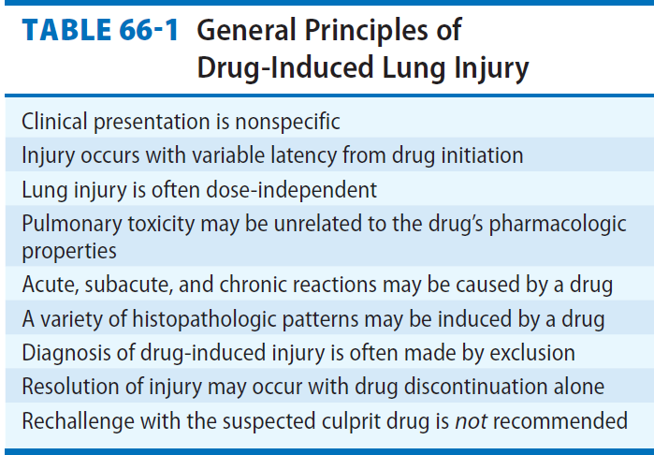
.
Drugs
Cases
Title
Pathophysiology
Risk Factors
Introduction

Slide 8
The likelihood of developing adverse pulmonary effects from drugs remains largely unpredictable .
Some of the known risk factors for these selected drugs include the following:
Cases
Drugs
Title
Introduction
Pathophysiology
Risk Factors

Slide 9
The likelihood of developing adverse pulmonary effects from drugs remains largely unpredictable .
Some of the known risk factors for these selected drugs include the following:
Cases
Drugs
Title
Introduction
Pathophysiology
Risk Factors

Slide 10
Advanced age
Cumulative dose
Simultaneous oxygen therapy
Combination therapy
(Coadministration of cisplatin and bleomycin ,The combination of vinblastine and mitomycin increases the risk of asthma.)
Radiation therapy
Occupational factors ( Asbestos & bleomycin )
Underlying lung disease
Genetic factors
Cases
Drugs
Title
Introduction
Pathophysiology
Risk Factors

Slide 11
Mechanisms of pulmonary injury
Pulmonary toxicity secondary to drugs may be due to a variety of mechanisms, such as the following:
Oxidant injury.
Pulmonary vascular damage.
Deposition of phospholipids within cells.
Immune system–mediated injury.
Central nervous system (CNS) depression.
Direct toxic effect.
Drugs
Introduction
Risk Factors
Title
Cases
Pathophysiology

Slide 12
Interstitial pneumonitis
Interstitial pneumonitis (ie, inflammation of the lung interstitium) is the most common manifestation of drug-induced lung disease.
A wide array of drugs can cause interstitial pneumonitis. Some of the agents implicated are azathioprine, bleomycin, MTX, phenytoin, statins, amiodarone, and sulfasalazine.
Drugs
Introduction
Risk Factors
Title
Cases
Pathophysiology

Slide 13
NCPE
A variety of drugs can cause NCPE. This is a less common pattern of drug-induced involvement than pneumonitis and fibrosis.
Drugs can cause pulmonary edema by two mechanisms:
Capillary endothelial injury, leading to leakage of fluid and protein into the lung interstitium.
Certain drugs depress the central nervous system (CNS), resulting in neurogenic pulmonary edema.
Drugs
Introduction
Risk Factors
Title
Cases
Pathophysiology

Slide 14
NCPE
Clinically, acute NCPE manifests as an acute onset of dyspnea with tachypnea, tachycardia, hypoxemia, and diffuse crackles on physical examination. Fluffy infiltrates are present on the chest radiograph.
Drugs
Introduction
Risk Factors
Cases
Title
Pathophysiology

Slide 15
Drugs that cause NCPE include the following :
Heroin
Interleukin 2
Methotrexate (MTX)
Cocaine
Tocolytic agents
Hydrochlorothiazide
Cyclophosphamide
Iodinated radiographic contrast agents
Drugs
Introduction
Risk Factors
Title
Cases
Pathophysiology

Slide 16
Hypersensitivity reaction
Drug hypersensitivity results from interactions between a pharmacologic agent and the patient’s immune system. These reactions are commonly associated with nitrofurantoin, MTX, beta-blockers, and procarbazine.
Drugs
Introduction
Risk Factors
Title
Cases
Pathophysiology

Slide 17
BOOP ( Bronchiolitis obliterans-organizing pneumonia)
BOOP is a distinctive pattern of lung response to a few drugs. Histology reveals interstitial inflammation superimposed on the dominant background of alveolar and ductal fibrosis.
Drugs
Introduction
Risk Factors
Title
Cases
Pathophysiology

Slide 18
Drugs that can cause BOOP include the following:
Acebutolol
Amiodarone
Amphotericin B
Bleomycin
Carbamazepine
Drugs
Introduction
Risk Factors
Title
Cases
Pathophysiology

Slide 19
Pulmonary vascular disease
Venous thromboembolism (DVT & PE)
The exact mechanism by which drugs increase the risk for thromboembolism is still unknown. But many theories may attribute to thrombus formation
Direct endothelial damage and expose the underlying subendothelium thus leading to platelet adherence and subsequent thrombus formation. (e.g contrast media and cytotoxic drugs)
Drugs
Introduction
Risk Factors
Title
Cases
Pathophysiology

Slide 20
Attenuate the secretion of pro- and anticoagulation mediators by the endothelial cells and may have prothrombotic effects on platelets by increasing adhesion and aggregation.( e.g COCs)
Decreased blood flow by increasing blood viscosity. (e.g intravenous immunoglobulin administration)
Drugs
Introduction
Risk Factors
Title
Cases
Pathophysiology

Slide 21
Other implicated drugs include
Phenytoin
Procainamide
Retinoic acid
Drugs
Introduction
Risk Factors
Title
Cases
Pathophysiology

Slide 22
B) Pulmonary hypertension
Appetite suppressants (eg, amphetamines, fenfluramine, dexfenfluramine) are associated with an increased risk of pulmonary hypertension.
Prescription medications such as beta-blockers and mitomycin C have also been reported to cause pulmonary hypertension.
Drugs
Introduction
Risk Factors
Title
Cases
Pathophysiology

Slide 23
C)Pulmonary Vasculitis/ hypersensitivity pneumonitis
Drugs that cause pulmonary vasculitis, including nitrofurantoin, sulfonamides, penicillins, phenytoin, and propylthiouracil.
Drugs
Introduction
Risk Factors
Title
Cases
Pathophysiology

Slide 24
D) Diffuse alveolar hemorrhage
Patients usually present with hemoptysis, dyspnea, and hypoxemia. Diffuse alveolar hemorrhage is characterized by bilateral infiltrates in the context of anemia of recent onset and hypoxemia.
Drugs
Introduction
Risk Factors
Title
Cases
Pathophysiology

Slide 25
Drugs include
Anticoagulants
Cytosine arabinoside
MTX
Carbamazepine
Cocaine,
Hydralazine
Mitomycin C
Penicillamines.
Drugs
Introduction
Risk Factors
Title
Cases
Pathophysiology

Slide 26
Bronchospasm
Aspirin and other nonsteroidal anti-inflammatory drugs (NSAIDs) can induce bronchospasm (8-20% of adults with asthma). The acute asthmatic reaction occurs within 20 minutes to 3 hours after ingestion of the drug.
Drugs
Introduction
Risk Factors
Title
Cases
Pathophysiology

Slide 27
Bronchospasm has also been reported with the use of the following agents:
Inhaled pentamidine/ acetylcysteine.
Amphotericin B
Amiodarone
Angiotensin-converting enzyme (ACE) inhibitors (ACEIs)
Beta-blockers
ARVT for HIV.
Drugs
Introduction
Risk Factors
Title
Cases
Pathophysiology

Slide 28
Pleural involvement
Pleural effusions can develop in patients undergoing treatment with MTX, nitrofurantoin, amiodarone, procarbazine, carmustine, or cyclophosphamid.
Drugs
Introduction
Risk Factors
Title
Cases
Pathophysiology

Slide 29
Pleural effusions can also occur in drug-induced lupus; medications in this setting include hydralazine, procainamide, phenytoin, nitrofurantoin, and ACEIs.
Positive serum testing for antinuclear and histone antibodies aids in the diagnosis of this disorder.
Drugs
Introduction
Risk Factors
Title
Cases
Pathophysiology

Slide 30
Bilateral pleural thickening is a distinctive form of late cyclophosphamide toxicity.
Pneumothorax can complicate late stages of drug-induced pulmonary changes and has been reported in association with bleomycin, carmustine, and retinoic acid.
Drugs
Introduction
Risk Factors
Title
Cases
Pathophysiology

Slide 31
Mediastinal involvement
Enlargement of hilar and mediastinal lymph nodes may be produced by phenytoin, bleomycin, and carbamazepine can induce.
Pseudosarcoidosis syndrome can develop with interferon alfa and beta.
Drugs
Introduction
Risk Factors
Title
Cases
Pathophysiology

Slide 32
Mediastinal lipomatosis
It is the accumulation of excess unencapsulated fat within the mediastinum. It may be seen in patients with Cushing disease or those treated with corticosteroid therapy.
The usual appearance on the chest radiograph is a smooth widening of the anterior and superior mediastinum without any deformity of the trachea. The fat pads in the costophrenic angles are also often enlarged. The diagnosis is made based on chest computed tomography (CT) scan findings.The treatment is cessation of steroid therapy.
Drugs
Introduction
Risk Factors
Title
Cases
Pathophysiology

Slide 33
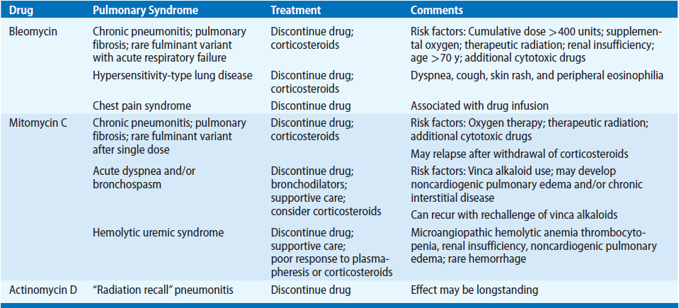
Exclusion Criteria
Risk
Title
Drugs
Introduction
Pathophysiology

Slide 34
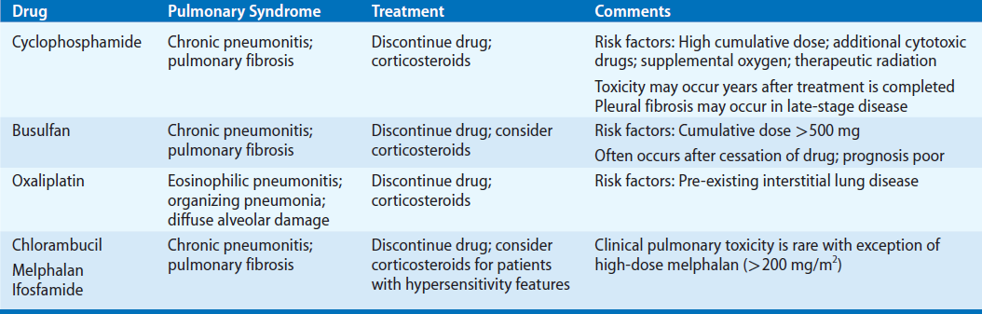
Exclusion Criteria
Risk
Title
Drugs
Introduction
Pathophysiology

Slide 35
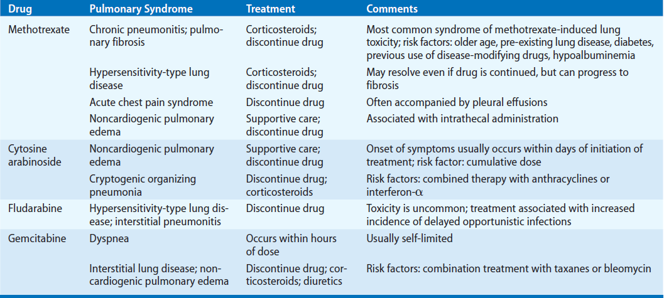
Exclusion Criteria
Risk
Title
Drugs
Introduction
Pathophysiology

Slide 36
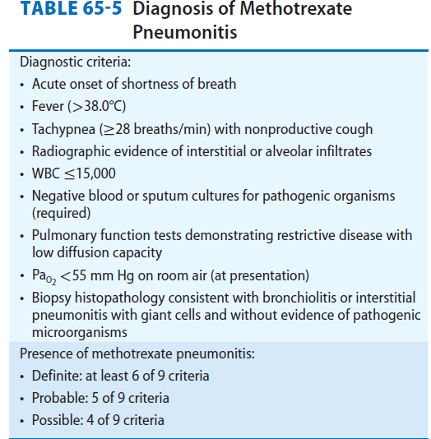
Exclusion Criteria
Risk
Title
Drugs
Introduction
Pathophysiology

Slide 37
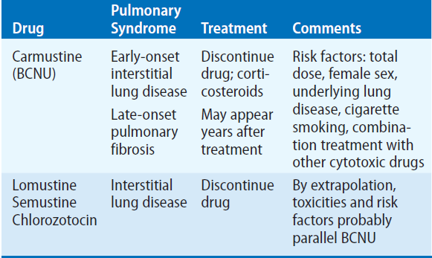
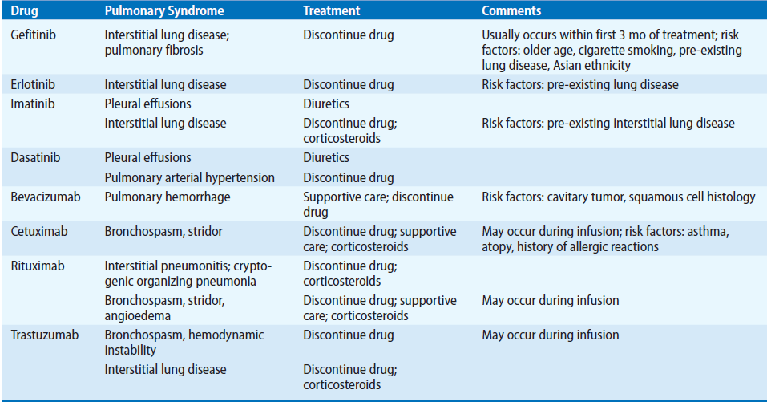
Exclusion Criteria
Risk
Title
Drugs
Introduction
Pathophysiology

Slide 38
Case (1)
Male patient 55 years old is known to have IHD maintained on ACE inhibitors, statins and aspirin. The patient presented to our outpatient clinic complaining of persistent dry cough over the past 6 weeks.
Q: Mention your possible diagnosis and your management.
Exclusion Criteria
Risk
Title
Cases
Introduction
Clinical picture

Slide 39
Answer 1:
The most possible Dx is Aspirin-induced asthma or dry cough mediated by ACE inhibitors.
Cessation of ACE inhibitors and its replacement with ARBs is a better choice.
Giving antihistamine, leukotriene receptor blocker with a bronchodilator can help to minimize symptoms.
Exclusion Criteria
Risk
Title
Cases
Introduction
Clinical picture

Slide 40
Case 2 :
35 years old female patient admitted to Respiratory intensive care unit ( RICU) due to massive pulmonary embolism. The patient received Streptokinase followed by I.V heparin as anticoagulant. 2 days later, the patient developped haemoptysis, anaemia, hypoxia and bilateral pulmonary infiltrates.
Q: Give the possible diagnosis.
Exclusion Criteria
Risk
Title
Cases
Introduction
Clinical picture

Slide 41
Answer 2 :
The most possible diagnosis is diffuse alveolar haemorrage caused by anticoagulants given.
Exclusion Criteria
Risk
Title
Cases
Introduction
Clinical picture

Slide 42
Case 3 :
An 80-year-old woman complains of dry cough and progressive SOB over the past 4 weeks. Her past medical Hx includes rheumatoid arthritis 5 yrs ago maintained on prednisolone 10 mg/day and MTX 15 mg/wk and she had started anti-TNFa therapy 3 months ago. The patient is tachypnic,hypoxic ( SaO2 at rest 81% on room air)
Q: what is your differential diagnosis.
Exclusion Criteria
Risk
Title
Cases
Introduction
Clinical picture

Slide 43
Answer 3 :
Methotrexate:
Sub acute interstitial pneumonitis
Corticosteroids :
Increase the risk for pnemonia
Anti-TNFa:
Increase risk for pneumonia
Exclusion Criteria
Risk
Title
Cases
Introduction
Clinical picture

Slide 44

Exclusion Criteria
Patients
Title
Introduction
Methods
Aim of the work

